Slide 1
Computer Vision: Digital Image formation
Umberto Castellani

Slide 2
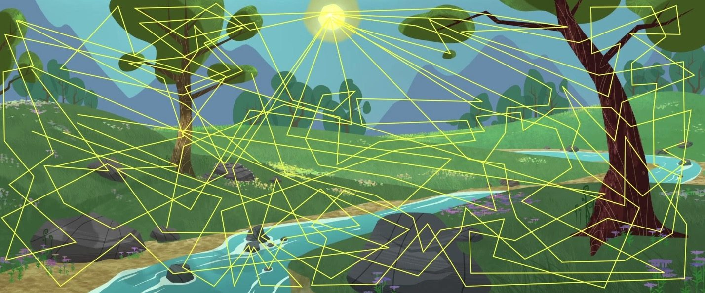
Path tracing
https://www.youtube.com/watch?v=frLwRLS_ZR0

Slide 3
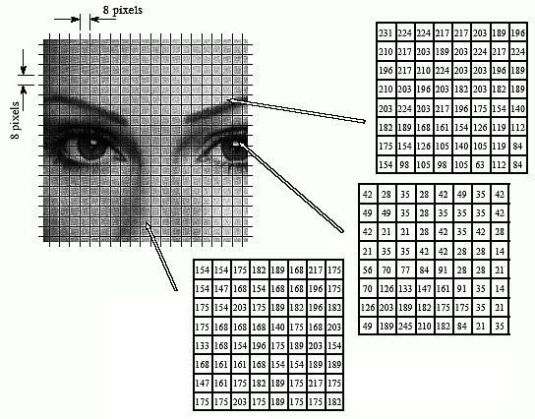
Digital images
Intesity images: the familiar, photofraphilike images encoding light intesities, acquired by an optical camera
Intensity images measure the amount of light impinging on a photosensitive device,
A digital image is a 2D-array (matrix) of numbers
Image Credits: https://www.dspguide.com/ch27/6.htm

Slide 4
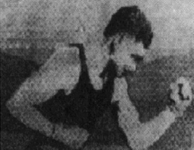
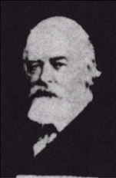
Digital images
Image transmitted from New York to London using a telegraph in the 1920s. It was possible to transmit the images over the ocean in less than 3 hours (with a ship it required more than a week)
Notes:
- Da più di una settimana a meno di 3 ore

Slide 5
Digital images
The exact relationship of a digital image to the physical world is determinated by the acquisition process, which depends on the sensor used,
Any information containded in the image must be computed from 2-D numerical arrays, in which it is encoded.

Slide 6
Image formation
The main concepts of intensity image acquisition are:
Optical process,
Photometric process,
Image geometry,
Image digitization.

Slide 7
Optical parameters of the lens
Lens type,
Focal length,
Field of view,
Angular aperture,

Slide 8
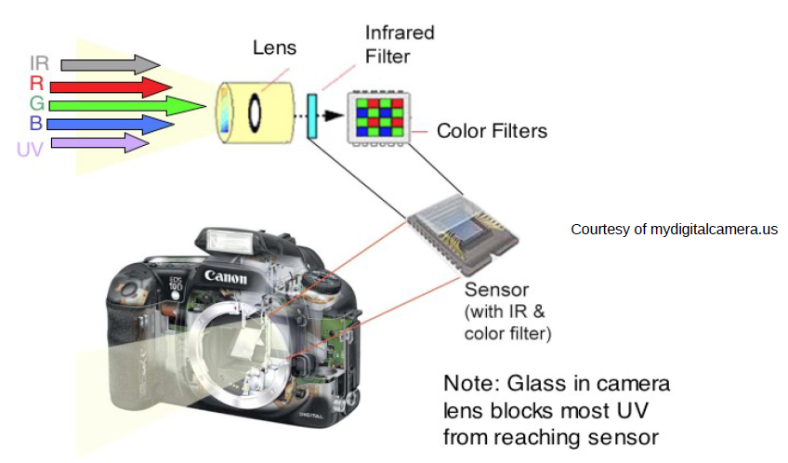
Optical process
The light rays enter the camera through an angular aperture (or pupil), and hit a screen or image plane,
On this plane there is a photosensitive device which registers light intensity,
The most of these rays are the result of the reflections of the rays emitted by the light sorces and hitting object surfaces

Slide 9
Image focusing
Any single point of a scene reflects light coming from possibly many directions, so that many rays reflected by the same point may enter the camera,
All rays coming from a single scene point, P, must converge onto a single point p onthe image plane (p is the image of P),
If this happen we say that the point P is in focus

Slide 10
Optical process
To obtain an in focus image:
Reduce the camera’s aperture to a point, called pinhole. This means that only one ray from any given point can enter the camera, and create a one-to-one correspondence between visible points, rays, and image points,
Introduce an optical system composed by lenses, apertures, and other elemets explicitly designed to make all rays coming from the same 3-D point converge ono a single image point.
Exposure time: how long the image plane is allowed to receive light

Slide 11
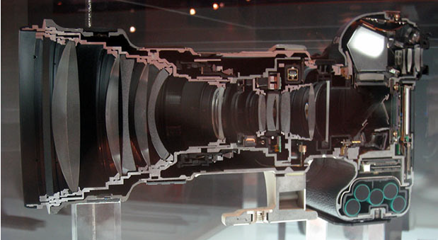
Optical process

Slide 12
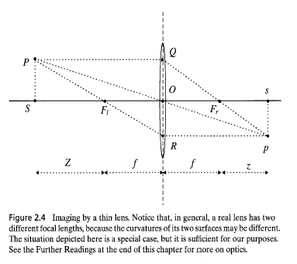
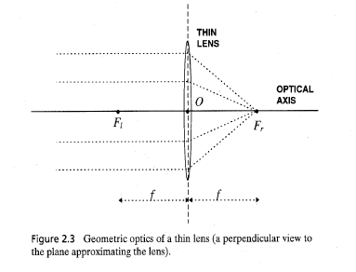
Thin lenses
Image Credits: Trucco-Verri 97
Elements:
Optical axis,
Lens center O,
Left and right focus F_{l}, F_{r} placed on the opposite side of the lens, at the same distance f from the center O called focal length of the lens

Slide 13
Thin lenses
Image Credits: Trucco-Verri 97
Basic properties:
Any ray entering the lens parallel to the axis on one side goes through the focus on the other side,
Any ray entering the lens from the focus on one side emerges parallel to the axis on the other side,
The ray going through the lens center, O, namend the principal ray, goes through p undeflected

Slide 14



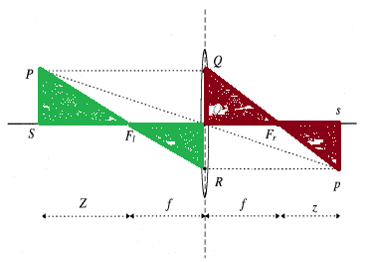
Thin lenses
Fundamental equation of Thin Lenses:

Slide 15
In focus point
The principal ray generates the image point p on the image plane, the other rays coming from P that enter the lens improve the light intesity of p.
The point is in focus at the distance from the lens identified by the thin lens equation, if the image plane is far from this distance the point is not in focus → circle of confusion
If the diameter of the circle of confusion is less than the dimension of image cells the point is in focus.

Slide 16
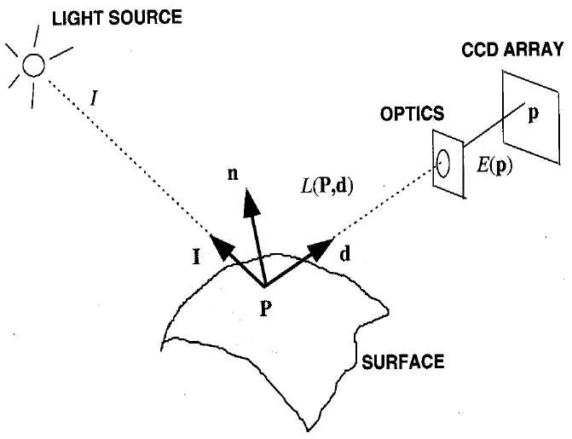
Basic Radiometry
Image Credits: Trucco-Verri 97
Radiometry: is the part of image formation concerned with the relation among the amount of light energy emitted from the light sources, reflected from surfaces, and registered by sensors

Slide 17
Basic Radiometry
Image Credits: Trucco-Verri 97
Two objectives:
Modelling how much of the illuminating light is reflected by object surfaces,
Modelling how much of the reflected light actually reach the image plane of the camera.

Slide 18

Basic Radiometry
Lambertian model:
It assumes that each surface point appears equally bright from all viewing directions,
This is coherent with non specular surfaces (i.e., varius materials like wood, paper, etc.).
I is the incident light, n is the surface normal, and ρ is a positive constante called surface’s albedo depending by surface’s material.

Slide 19
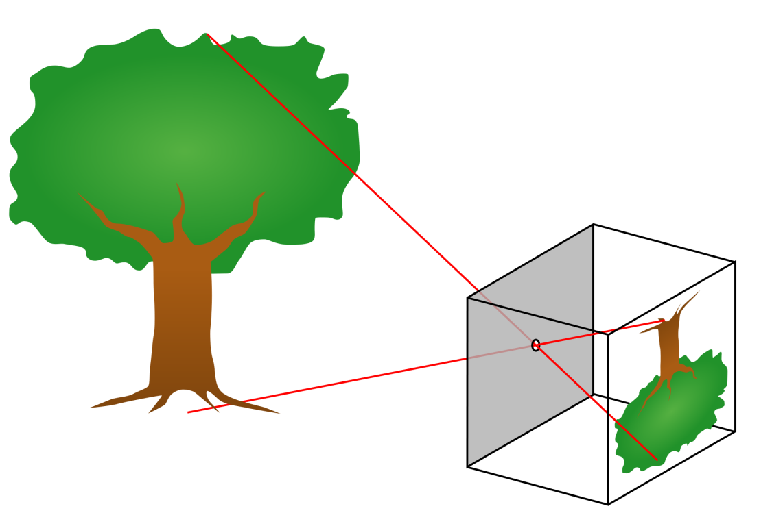
Image geometry
The simplest geometric model for image acquisition is the pinhole camera
Image Credits: Wikipedia http://en.wikipedia.org/wiki/Pinhole_camera

Slide 20
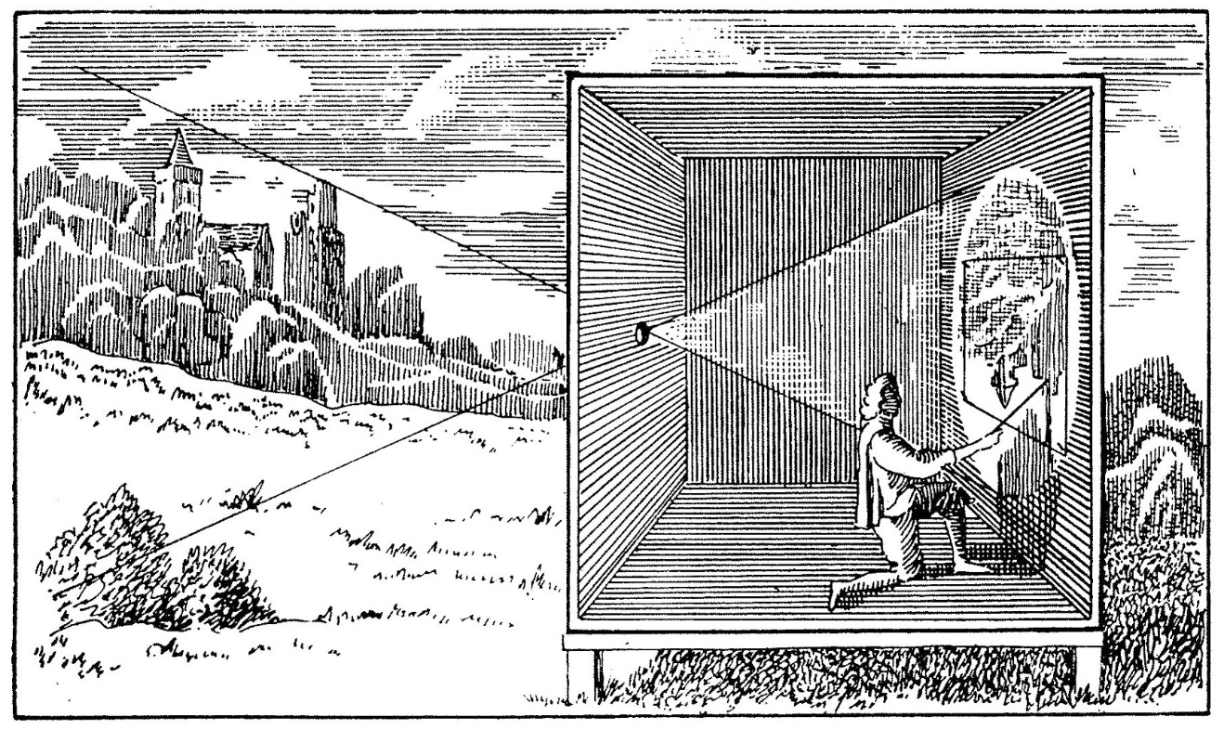
Image geometry
It comes from the principle of camera obscura from renaissance
Image credits: http://www.arabeschi.it/

Slide 21
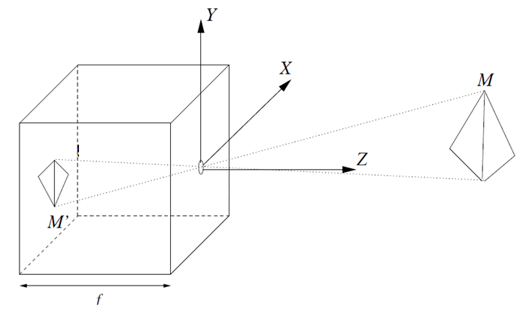
Image geometry
image
plane
C
Object
focal
plane

Slide 22
Image geometry
Ingredients:
The image is created on the image plane (or retina plane),
The hole C where the light enters the camera is the projection center or point of view or focus of projection,
f is the focal length, i.e., the distance between the image plane and C
The plane where C is lying that is parallel to the image plane is called focal plane,
N.B. Here the focal length is related to the image plane and not to the lens. This focal length and the focal lenght of the lens are two different quantities.

Slide 23
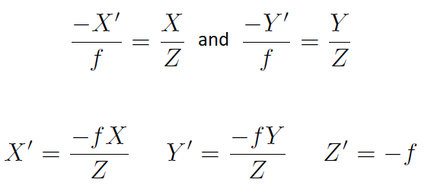
Image geometry
Equations:
These equations define the projective perspective image acquisition process.

Slide 24
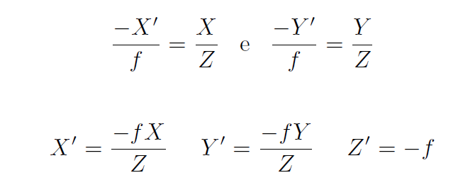
Image geometry
Equations:
The denominator term Z is the couse of the perspective effect: the dimension of the projection of an object to the image depends by its distance to the observer.

Slide 25
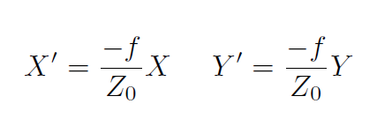
Image geometry
When the observed object is very thin, with respect to its distance from the camera, we can approximate the projective perspective with orthographic projection (scaled) or weack perspective.
When the depth Z is given by Z₀ ± ΔZ con (ΔZ/Z₀)<<1 the perspective factor f/Z can be approximated by the constant f/Z₀
This is an orthographic projection compoled by a scale of a scale factor f/Z₀
Notes:
Nota: Leonardo Da Vinci diceva di passare all’ortografica quando (ΔZ/Z₀)<1/10

Slide 26
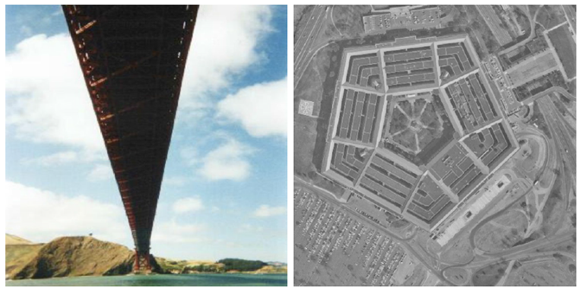
Image geometry
Perpective image: lines are converging.
Orthographic image: the distance to the observer is much larger than the size of the objects in the scene.

Slide 27
Digital images
In a digital camera the image plane is composed by a CCD (Charge-Coupled Device) or a CMOS (Complementary Metal-Oxide Semiconductor) matrix,
This matrix contains nxm elements of rectangular photosensor cells. Each photosensor cell converts light energy into voltage.
The video signal is digitized into a NxM matrix of integer values (eg., in [0, 255]), i.e., the digital image.
The element of this matrix are colled pixel (picture element) and NxM is the image size.

Slide 28


Digital images
In general, the intensity value of the image pixel is given by I(u,v)
The coordinate system u,v has the origin on the top-left of the image,
The CCD dimension nxm is not necessary the same as the image size NxM:
Since the CCD elements have a physical dimension (i.e., micron), it is possible to measure the so called effective horizontal and vertical sizes of the pixel (in meter).

